Slide 1
GENDER PAY GAP
May 3rd, 2025
Prepared By: Mariam Azam

Slide 2
Problem Statement:
A UK government department is concerned with monitoring the gender pay gap across different industries.

Slide 3
Aim
The UK-Wide Pay Gap
Large Pay Gaps
Conclusion
The average pay gap across different regions in UK
Companies with largest pay gaps
Pay gap w.r.t. factors (i.e., company size, industry type)
Limitations
Recommendations

Slide 4
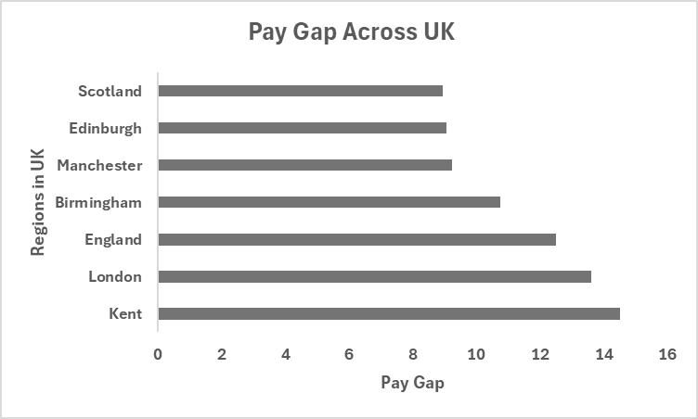
The UK-Wide Pay Gap
Pay Gap by Regions in UK
London VS Others

Slide 5
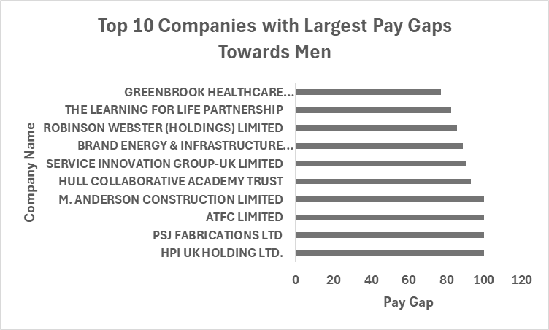
Largest Pay Gaps
Highest Median Pay Gap Towards Men

Slide 6
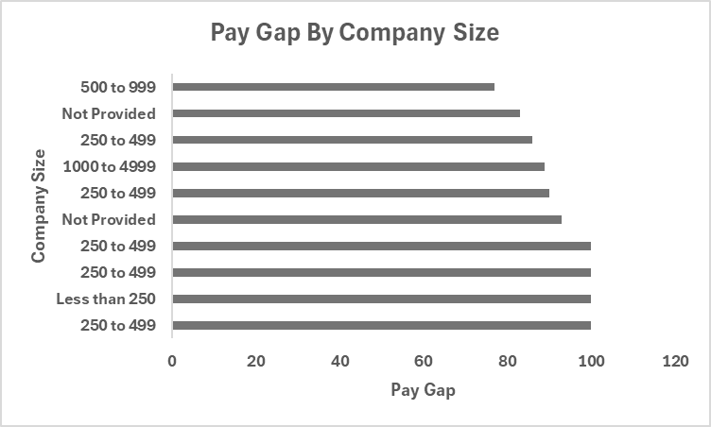
Largest Pay Gaps
With Respect to Company Size
The findings show that pay gap differs based on the company size

Slide 7
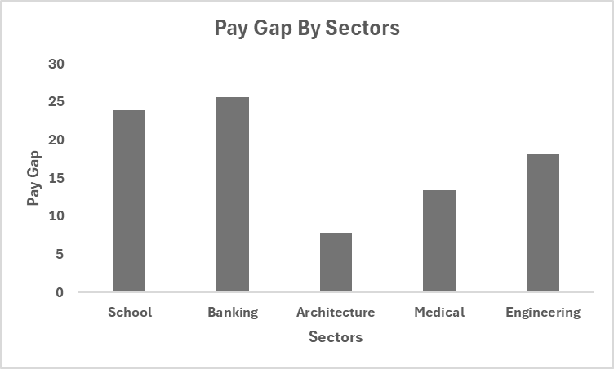
Largest Pay Gaps
With Respect to Sectors
The findings show that pay gap varies across different sectors

Slide 8
Conclusion
Limitations
The dataset has lacks sufficient information on:
Job Roles
Employment Type
Location
Recommendations
The dataset should include:
Employee Roles
Employment Type
Bonus Criteria
Region/City

